Slide 1
Project 2 ETL Data
Team Members:
Sonya Worrell
Charne Jewel-Hart
Mario Alcaraz
Fana Wachamo
April 8th 2021

Slide 2

Goal
Design and build a database that meets certain specifications using a requirements file.

Slide 3



Work Plan
Project Management & Development
Communication

Slide 4
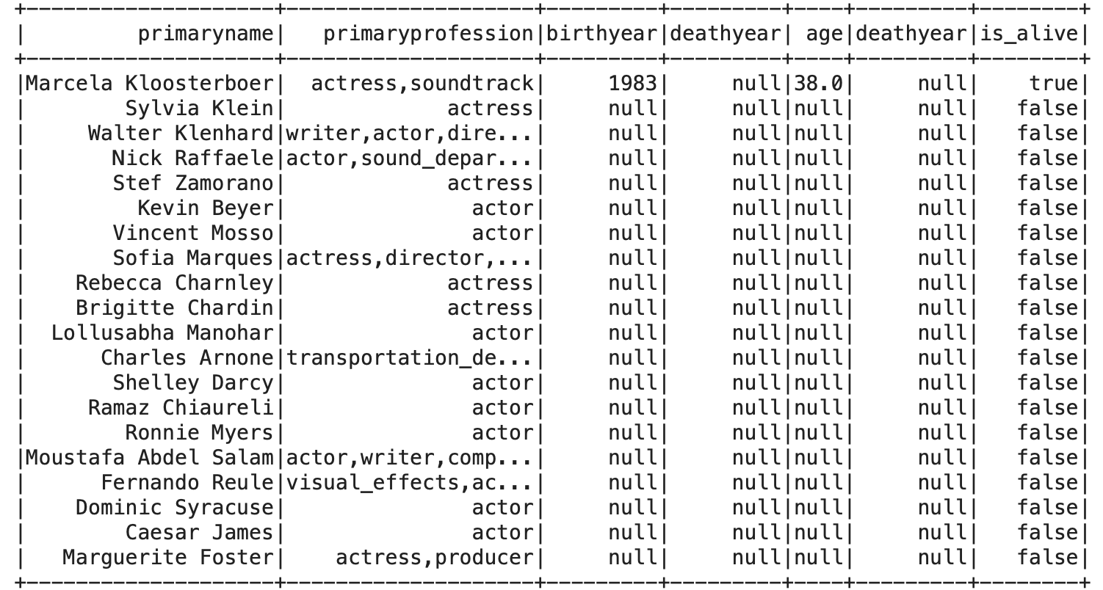
Requirement 1
Steps:
Identify the columns with the data needed.
Create new column “age” by extracting birth year from current date.
Check if age bigger than 120
If bigger than 120 set is_alive to true, else false.
Select only actors & actresses
Unique actors and actress' names.
Numerical field for age.
Boolean field to identify if the actor or actress is currently alive, deceased, or unknown.

Slide 5
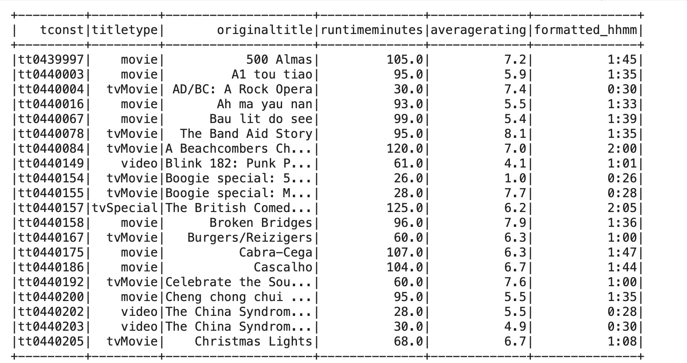
Requirement 2
Steps:
Drop unnecessary columns from titles_basic and ratings csv.
Join both data frames on tconst
Create function to convert min to HHMM.
Wrap function into udf.
Add “fromatted_hhmm” column passing the values from “runtimeminutes” to the function and return the value.
Character field for the original title,
Numerical field for the average critic rating
Character field for the type of film
A date-time field that has the runtime of the film in HH:MM

Slide 6
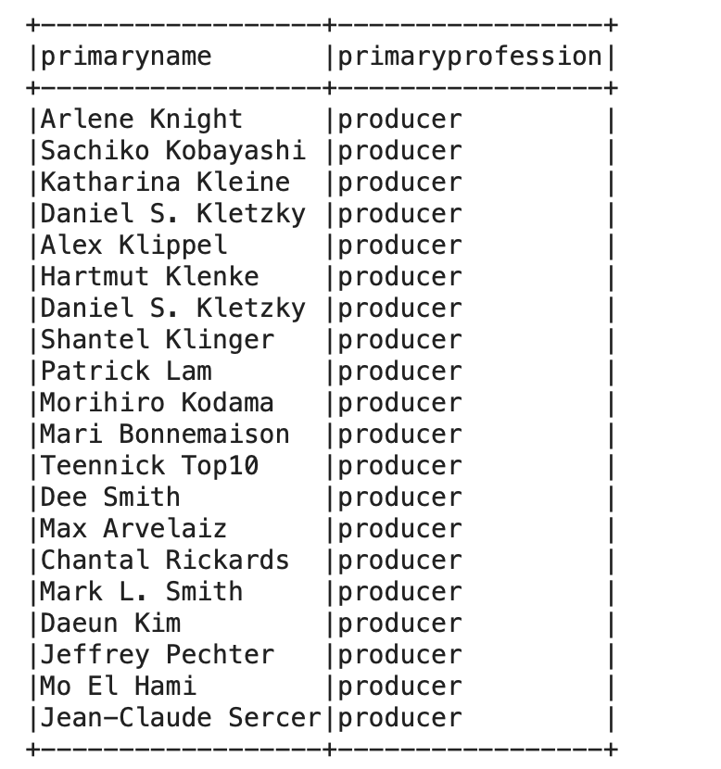
Requirement 3
Steps:
Drop the unnecessary columns so only the names and profession columns remains
Filter out the profession column to only people who are producers
A producer's table that contains only producers names and links to the film table.

Slide 7
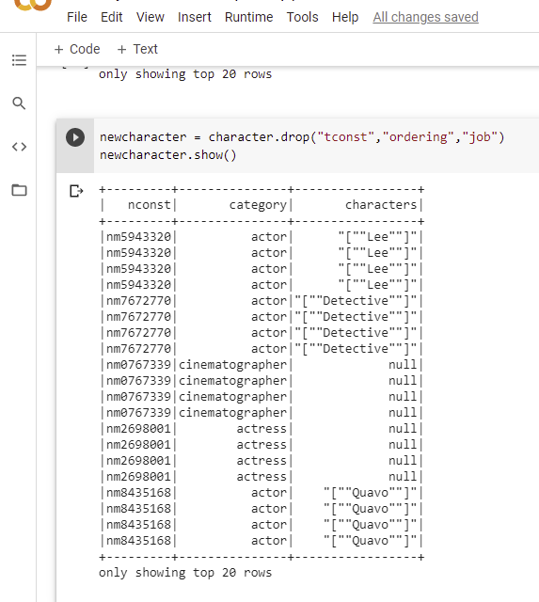
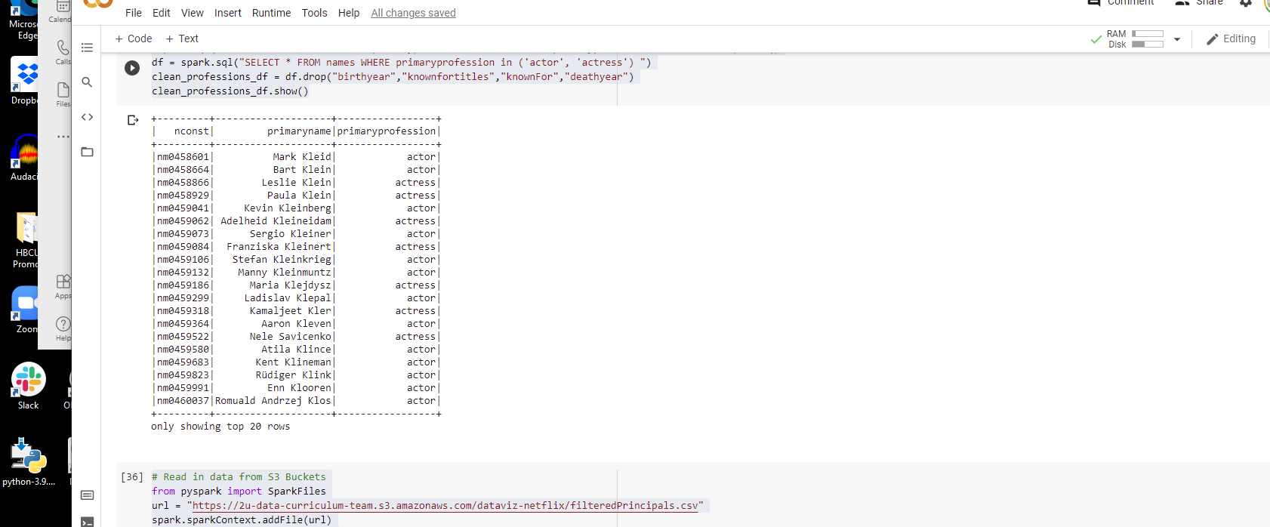
Requirement 4
Steps:
Selected Actor/Actress only from primaryprofession using spark.SQL statement
Dropped (birthyear, knownfortitles, knownFor, deathyear
Selected Actor/Actress only from primaryprofession
Dropped (tconst, ordering, job)
Common link between filterPrincipals.csv and filternames.csv are
nconst
category/primaryprofession (same info, not same column name)
A characters table with unique character names that links the actors and film tables together.

Slide 8
Questions?

Slide 9
Appendix

Slide 10
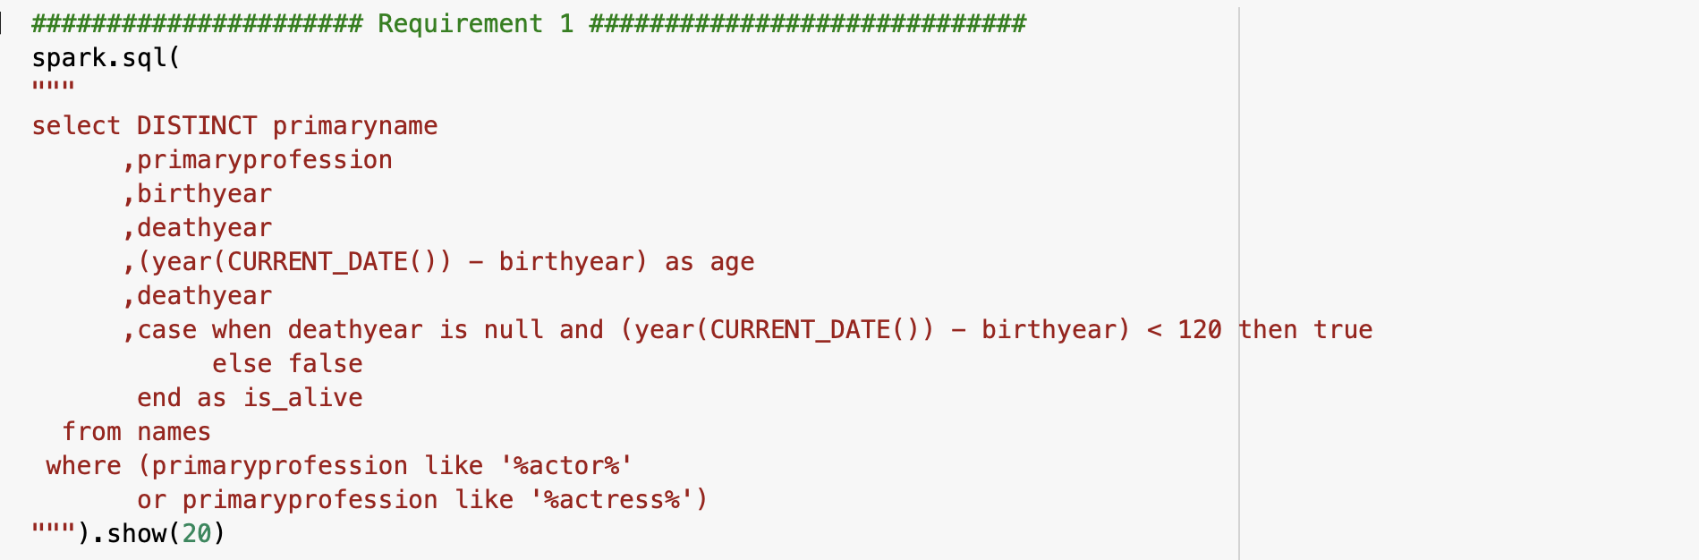
Code for #1

Slide 11
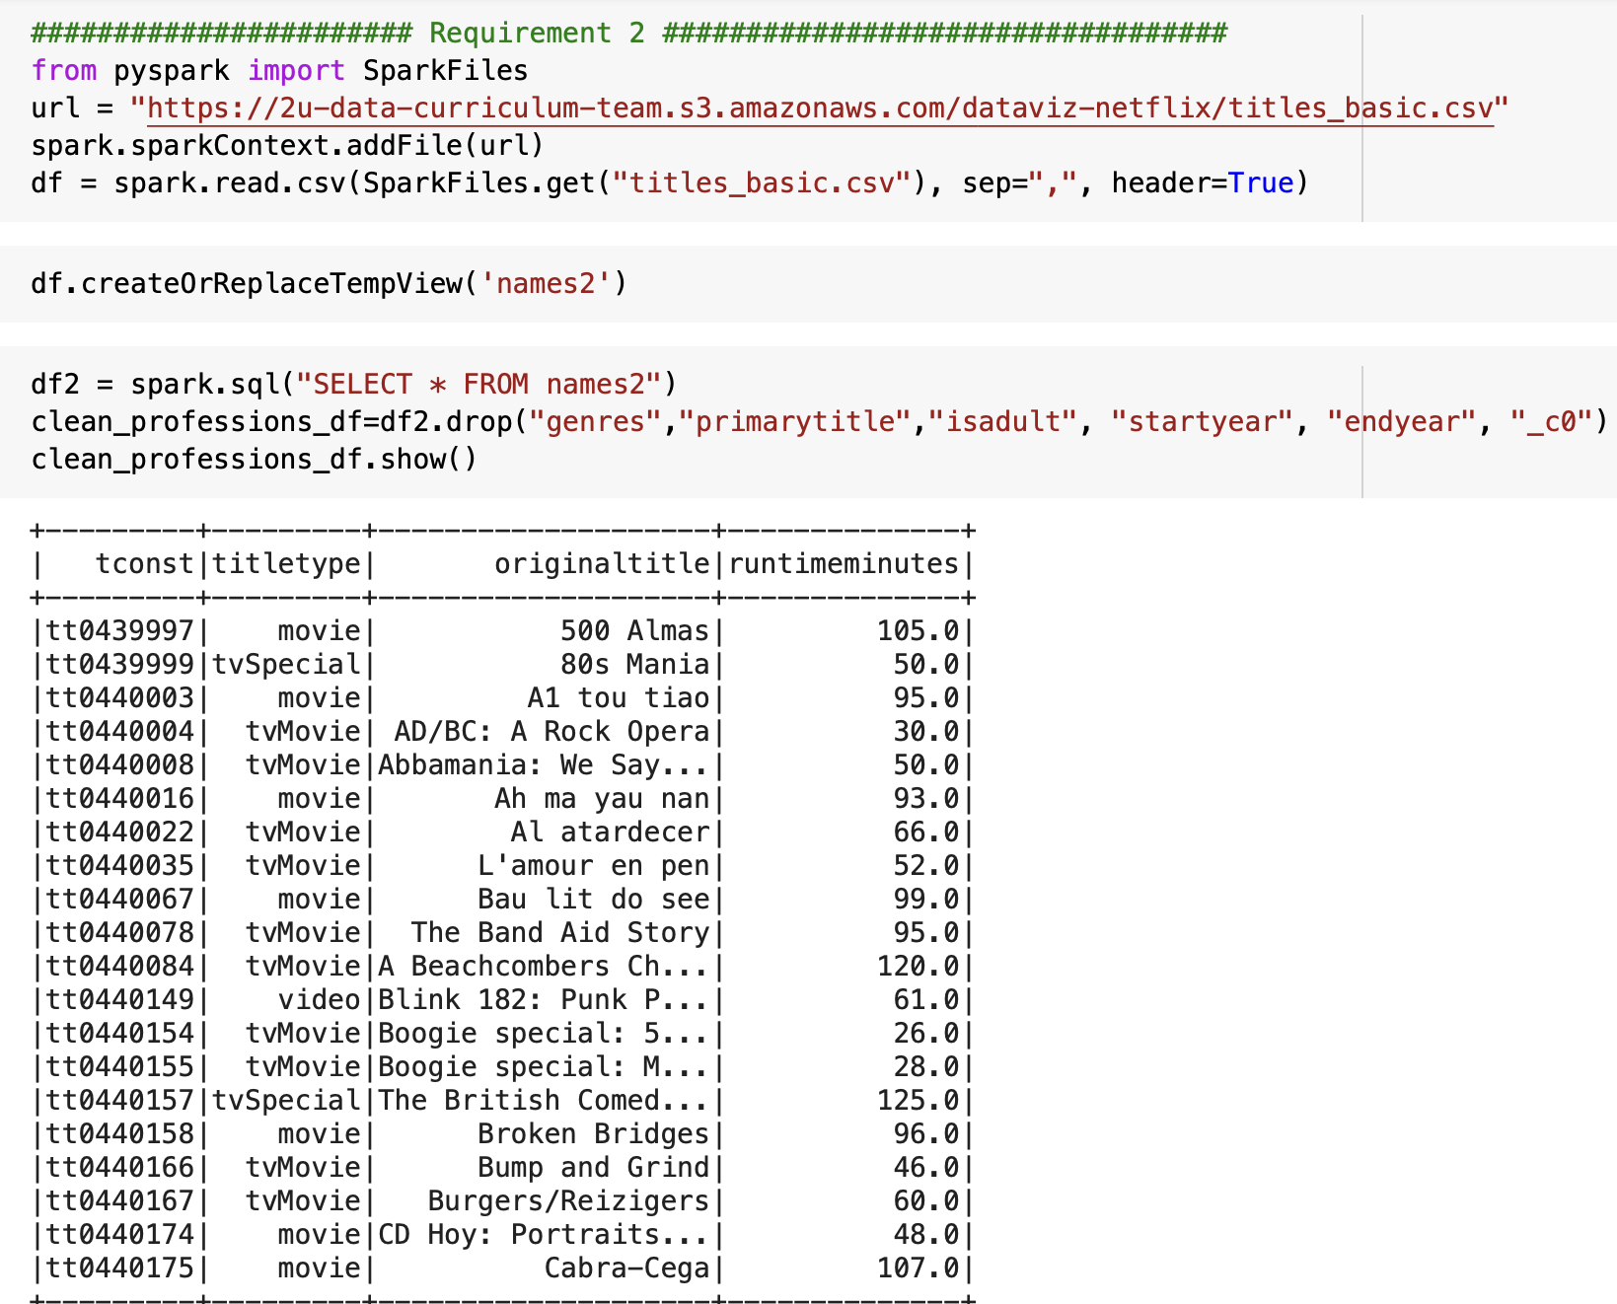
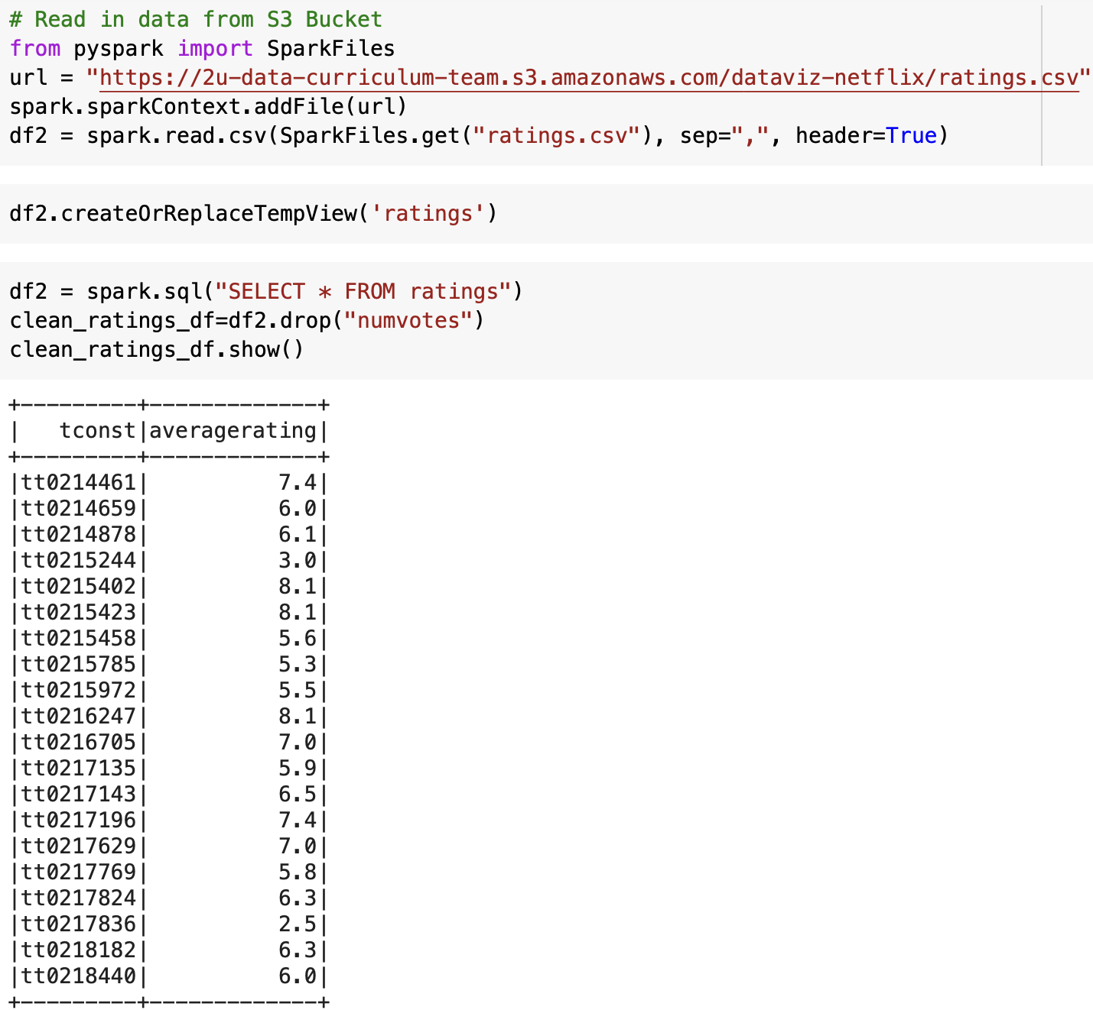
Code for #2

Slide 12
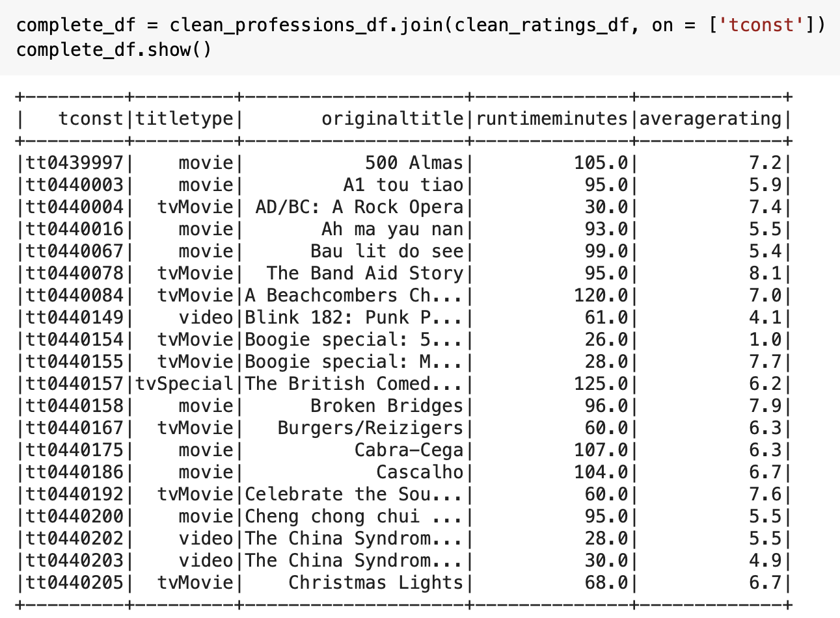
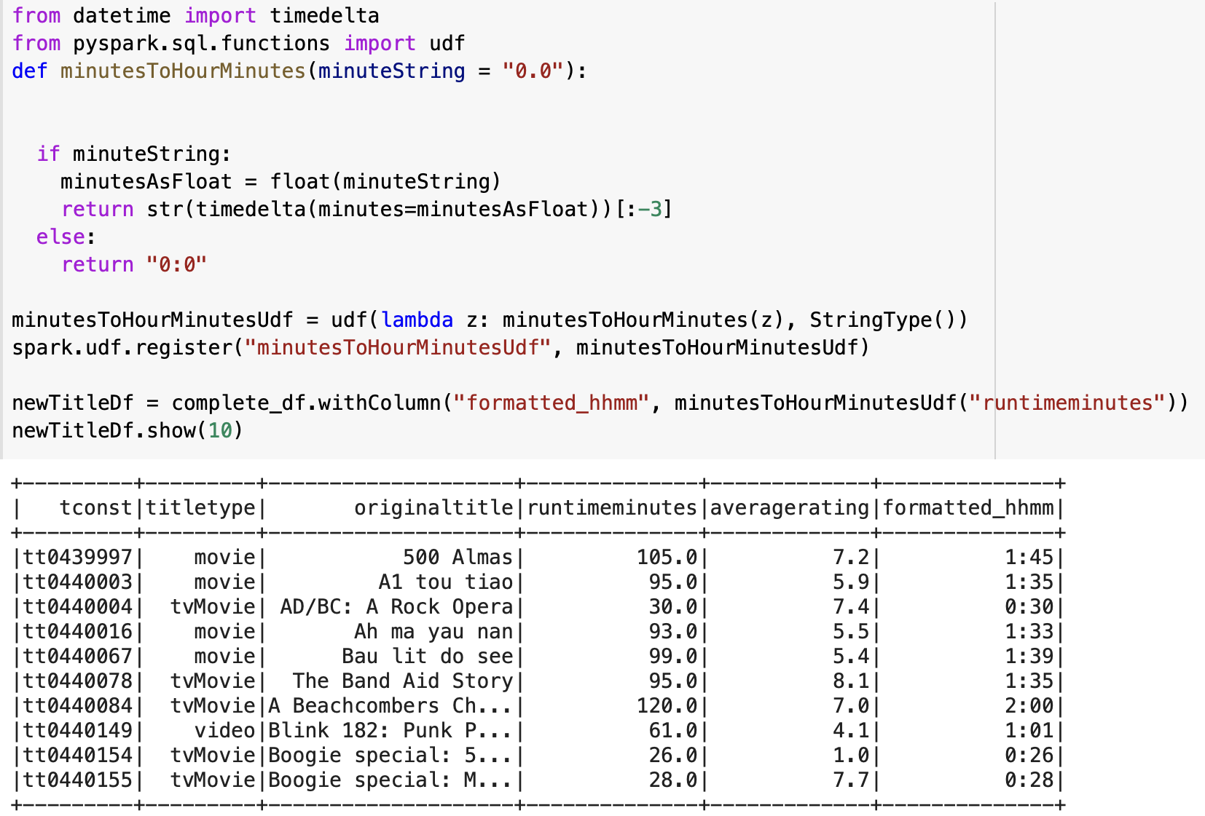
Code for #2

Slide 13
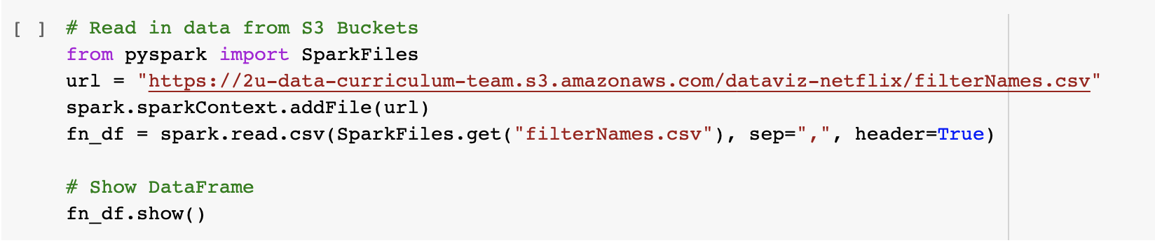
Code for #3

Slide 14
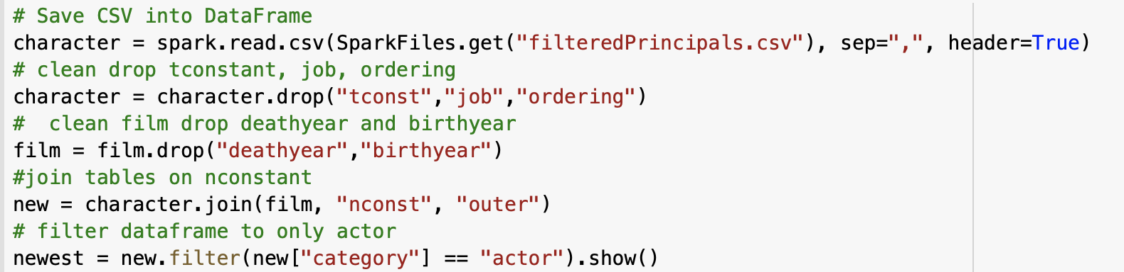
Code for #4
A characters table with unique character names that links the actors and film tables together.(Database 4)(Database 3)

Slide 15
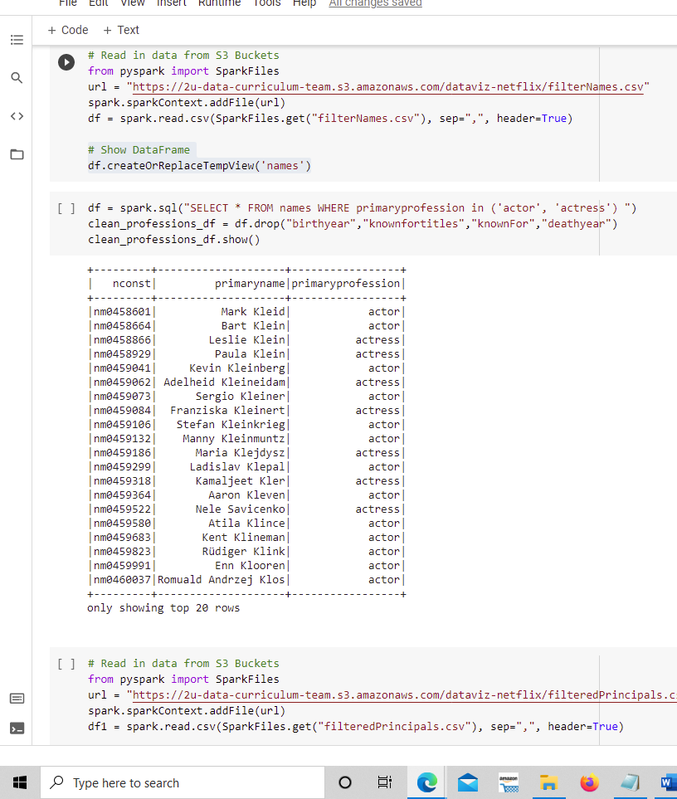
Code for #4
A characters table with unique character names that links the actors and film tables together.(Database 4)(Database 3)

Slide 16
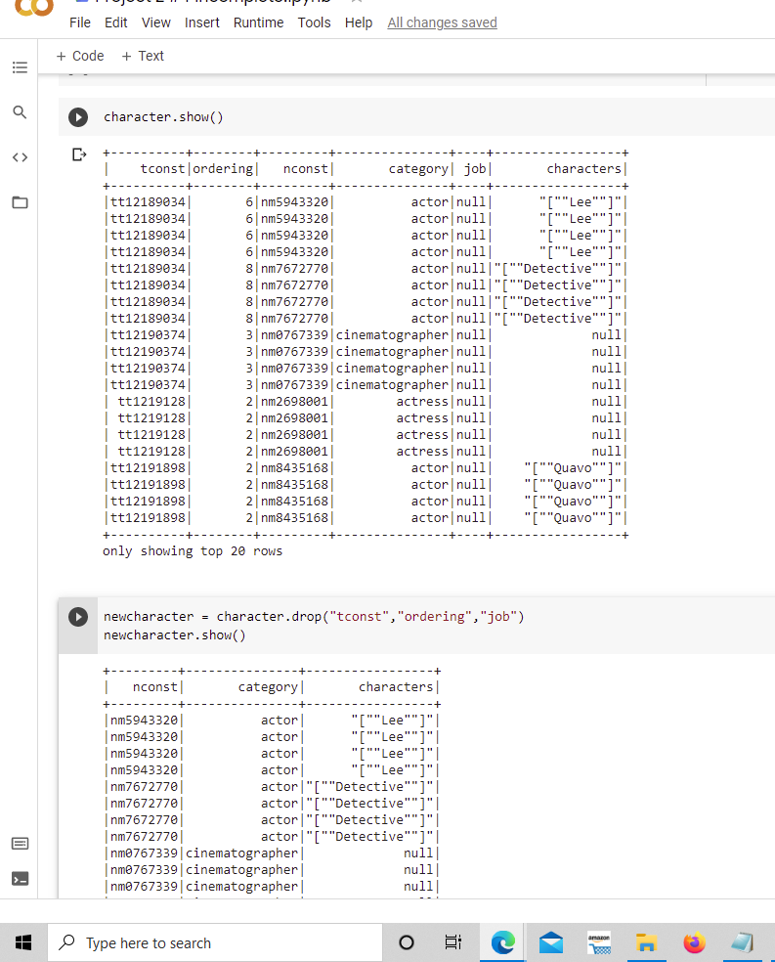
Code for #4
A characters table with unique character names that links the actors and film tables together.

Slide 17
Goal
Design and build a database that meets certain specifications using a requirements file.

Slide 18
Work Plan
Project Management & Development
Communication

Slide 19
Requirement 1
Steps:
Identify the columns with the data needed.
Create new column “age” by extracting birth year from current date.
Check if age bigger than 120
If bigger than 120 set is_alive to true, else false.
Select only actors & actresses
Unique actors and actress' names.
Numerical field for age.
Boolean field to identify if the actor or actress is currently alive, deceased, or unknown.

Slide 20
Requirement 2
Steps:
Drop unnecessary columns from titles_basic and ratings csv.
Join both data frames on tconst
Create function to convert min to HHMM.
Wrap function into udf.
Add “fromatted_hhmm” column passing the values from “runtimeminutes” to the function and return the value.
Character field for the original title,
Numerical field for the average critic rating
Character field for the type of film
A date-time field that has the runtime of the film in HH:MM

Slide 21
Requirement 3
Steps:
Drop the unnecessary columns so only the names and profession columns remains
Filter out the profession column to only people who are producers
A producer's table that contains only producers names and links to the film table.

Slide 22
Requirement 4
Steps:
Selected Actor/Actress only from primaryprofession using spark.SQL statement
Dropped (birthyear, knownfortitles, knownFor, deathyear
Selected Actor/Actress only from primaryprofession
Dropped (tconst, ordering, job)
Common link between filterPrincipals.csv and filternames.csv are
nconst
category/primaryprofession (same info, not same column name)
A characters table with unique character names that links the actors and film tables together.

Slide 23
Questions?

Slide 24
Appendix

Slide 25
Code for #1

Slide 26
Code for #2

Slide 27
Code for #2

Slide 28
Code for #3

Slide 29
Code for #4
A characters table with unique character names that links the actors and film tables together.(Database 4)(Database 3)

Slide 30
Code for #4
A characters table with unique character names that links the actors and film tables together.(Database 4)(Database 3)

Slide 31
Code for #4
A characters table with unique character names that links the actors and film tables together.

